Slide 1
Medtech CDMOs in 2025
Perspectives on activity in the Medtech CDMO market
May 2025

Slide 2
Global MedTech growth is projected at 4.6% for 2025
Global Medtech Revenue by Segment (USD$B and YoY%)
Comments
Ortho growth showed increasing interest in innovative implants and materials (e.g., collagen, 3D printing)
Cardiovascular growth is driven by an increased prevalence and awareness of heart disease
Surgery grew from a strong focus on MIS, as well as single-kitting to increase efficiency for surgeons and cut sterilization time
IVD was the main detractor, experiencing a sharp decline likely attributable to the decline in COVID-19 testing
5.9%
4.6%
5.8%
4.4%
4.0%
6.0%
5.4%
-5.3%
2.8%
5.2%
$557.8
$583.2
2024
Surgery
Diabetes Care
Digital Health & Patient Monitoring
Other Devices
2025
IVD
Ortho
Cardio
Imaging
Wound Care
Source: GlobaData; A&M estimates

Slide 3
By extension, the Medtech CDMO industry is also growing, with the US showing the most growth in 2023
Global Medtech CDMO Market 2021-2023 (USD$B)
Comments
Strong growth, led by the US market
US and Europe share similarities
Focus on high-value services and precision manufacturing
Play a critical role for Medtech OEMs (quality, speed, innovation)
European CDMO market faces structural challenges compared to the US
Fragmented market with numerous countries and varying regulations, but offers significant consolidation opportunities
Less tech-driven ecosystem to the US
Labor market and cost of goods variations create complexities
11.5%
91.0
81.5
73.2
65.7
11.6%
11.6%
12.3%
8.9%
13.1%
12.4%
9.4%
12.9%
10.7%
2021
2022
2023
2024*
US
Europe
ROW
*2024 values forecasted based on previous year-over-year growth
Source: Massachusetts Medical Device Industry Council. The 2024 Global Medtech Contract Manufacturing Report

Slide 4
MedTech first-time solo launches, bypassing licensing and M&A, also fueled the reliance on CDMO as a GTM strategy
Regulatory approval poses greater challenges for first-time applicants
Navigating complex regulatory pathways like PMA and 510(k) can be difficult, especially for first-time MedTech companies
On average, the 510(k) regulatory pathway takes 50% longer for a company with a first device than for companies with an already approved device
CDMOs provide additional support for solo launcher
Pricing and reimbursement: developing a robust pricing and reimbursement strategy is crucial for successful product adoption and appropriate reimbursement is essential for financial viability.
Outsourcing Support: offering specialized knowledge and resources and companies must invest in robust audit processes and supplier qualification programs to ensure product quality and safety.
Strategic Partnerships: engaging specialists for comprehensive launch planning can streamline processes and reduce time to market by assisting in creating a roadmap for commercialization, addressing administrative, regulatory, and financial goals.
Sources: RSM Medtech outlook: Successful solo launches require CDMO support and more

Slide 5
The 2024 capital market displayed a slight boost in both M&A activity and VC investments
Increasing volume of exits
Increasing VC investments
Of the 1,051 investment deals, only $597M or 8% (down from 13% in 2023) were disclosed as upfront payment potentially signaling a cautious investment approach
Four Medtech IPOs were completed raising a total of $744.5M; most notable: Tempus AI $411M, Fractyl Health $110M, and BrightSpring Health Services $693M
M&A activity surged with 305 acquisitions announced totaling $63.1B up from 134 in 2023, most notable:
J&J acquisition of Shockwave for $12.5B and V-Wave for $1.7B
Boston Scientific acquired Axonics for $3.7B and Silk Road for $1.2B
Recent M&A activity highlights strategic refocusing for Medtech players
Edwards divested its Critical Care Group to BD for $4.2B
Baxter spun off its renal care and acute therapies into publicly traded company in a $3.4B deal with Carlyle Group
VC funding rose 12% YoY to $19.1B secured across 691 rounds, a 5% decrease over 2023
42 rounds exceeded $100M and 79 rounds were over $50M indicating focus on high value opportunities; particularly in minimally invasive and digital health technologies
Most notable were Impress’ $117M and Nusano’s series C of $115M
Strong interest in early-stage healthcare saw a slight uptick, seed and series A funding raised $4B, likely driven by interest in AI-enabled devices
The FDA authorized 223 AI/ML devices in 2023 and 169 in 2024, compared to 64 in 2018
In 2023, the FDA authorized 124 novel devices, the highest in 40 years
Sources: J.P. Morgan, A&M analysis, FDA Annual Report 2023, FDA AI/ML authorization database

Slide 6
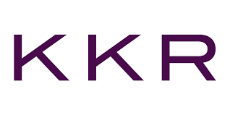
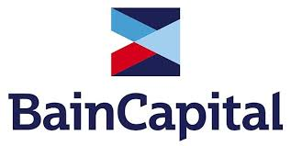
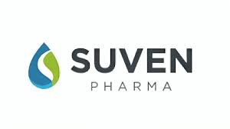
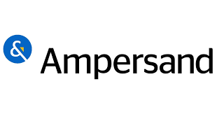
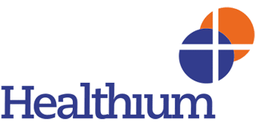
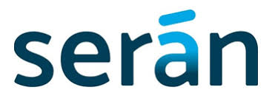
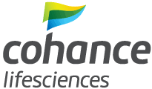
Featured deals of 2024 signal market appetite for specialized capabilities and an exit path for many mid-size PE-backed platforms
for est. $839M
Previous ownership:
Apax Partners
for $1.75B
Previous ownership:
AEA Investors
For $1.1B
Previous ownership:
Founders-owned
for est. $200M
Current ownership:
Vivo Capital
Undisclosed amount
Current ownership:
Advent International
acquired
acquired
acquired
invested
merged

Slide 7
PE capital continues to invest in Medtech CDMO platforms
Global PE-Backed CDMO Platforms from 2020-2024, Target (Sponsor)
2020
2021
2022
2023
2024
Syneo (Arcline)
Velosity (Graham Partners)
Wytech (Vance Street)
CMD (Inverness Graham)
RTI Surgical (Montagu)
Intech (Montagu)
Jecture (Glide Healthcare)
Addman (AIP)
Willow Wood (Blue Sea)
Sanner (GHG Capital)
CGI Automated (CORE Industrial)
Unisyn (AEA)
Resolution Medical (Arcline)
Velentium (Great Point)
Arch (MDP)
Resonetics (Carlyle)
PDC (Vance Street)
Arcotech (Carlyle)
Life Science Outsourcing (PPC)
Excel Scientific (Vance Street)
Clayens (One Equity Partners)
Biocoat (GTCR)
Sterling Medical (Ampersand)
Aspen Surgical (Linden)
Burke Porter Group (AEA)
Steripack (Inflexion)
Arterex (Invest Industrial)
Confluent (TPG)
Intricon (Altaris)
RE3DTECH (CORE Industrial)
MDI (Truarc)
Zeus (EQT)
Koscher & Würtz (Glide Healthcare)
AP Technologies (AGIC)
Quasar (Boyu Capital)
Biomerics (ONCAP)
Packaging Compliance Labs (SV Health)
Robling Medical (SB Health)
Straits Ortho (Quadria Capital)
HG Medical (Astorg)
Peters Surgical (Advanced Medical Solutions)
Healthium (KKR)
Johnson Matthey Plc MDC (Montagu)
Donatelle Plastics (DuPont)
Avid Biosciences (GHO Capital and Ampersand Capital Partners)
Seran Biosciences (Bain Capital)
Suven Pharmaceuticals / Cohance Lifesciences (Adven International)
5 deals
15 deals
11 deals
9 deals
7 deals

Slide 8
Earlier PE platform investments could be looking for an exit path
Global PE-Backed CDMO Platforms from 2013-2018, Target (Sponsor)
2013*
2015
2016
2017
2018
Vonco (Jacsten)
Caplugs (Berwind)
MGS (Mason Wells)
Viant (Water Street)
Tekniplex Consumer Products (Genstar)
Cirtec Medical (3i Group)
MW Industries (American Securities)
Westfall Technik (Blackbern Partners)
Tecomet (Charlesbank)
SGH Medical Pharma (Merieux)
Fralock Holdings (Arsenal Capital Partners)
Avalign Industries (Linde)
Team Technologies (Clearlake)
Vander-Bend Manufacturing (Aterian)
Cadence (Kohlberg & Co)
Gener8 (Sverica)
1 deal (No deals in 2014)
1 deal
2 deals
5 deals
7 deals
*There were no deals in 2014, so 2013 is shown

Slide 9
Thank you

Slide 10
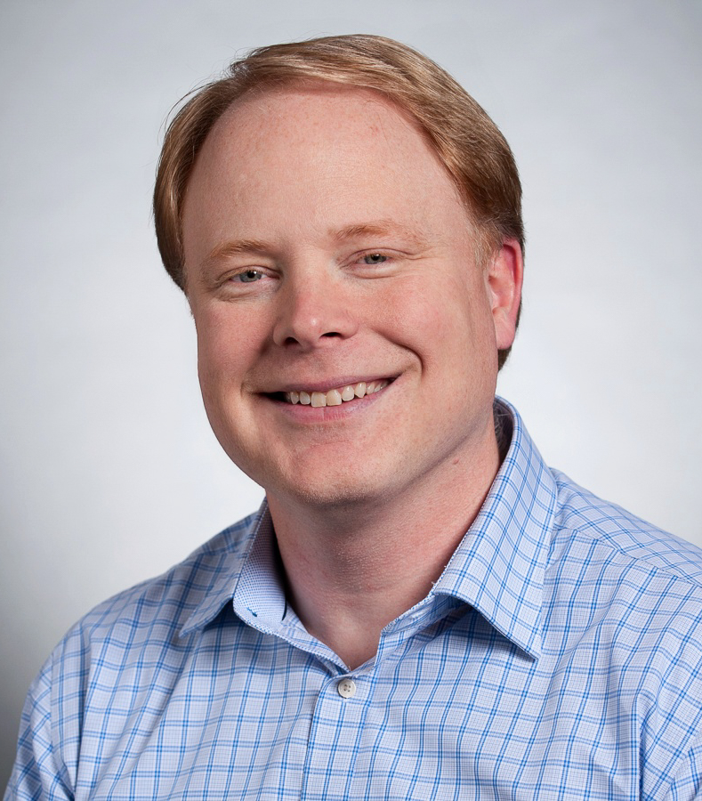
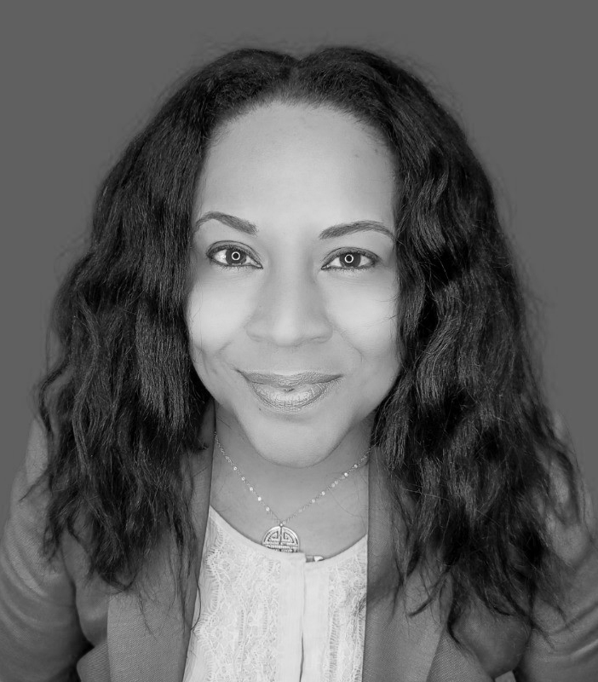
Authors
Acknowledgments
The authors would like to thank
the following for their contributions to this report:
Private Equity Practice
Mark Schmidt
Corporate Transactions Group
Marcos Cortes
Transactions Advisory Group
Simon Joyeux
Mark Freitas
Managing Director
Boston
Nile Harris
Director
Nashville
Mahak Kanjolia
Consultant
New York

